Slide 1
Smart Agriculture System using IoT
By Trapti Jain
IoT App Developer at SmartInternz
Notes:
Hi Guys,
I am Madhav

Slide 2
Project Overview
Plants and water have had and still have a key role in the history of life on earth. They are responsible for presence of oxygen needed for human survival on this planet. At the same time agriculture is also important to human beings because it forms the basis for food security. It helps human beings to grow appropriate crops with right nutrients and raise the animals in accordance to environmental factors.
Agriculture plays a crucial in country’s development and any country’s stand in the world can be determined by this sector. Agriculture plays a vital role in India’s economy. Over 58% of the rural areas depend on agriculture as their main source of livelihood. Agricultural export constitutes 10% of the country’s export. Yet farmers are using traditional techniques for agriculture and most of the farmers still depend on rain for irrigation. The farmer’s and even the nation’s economy will be ruined if there are no proper yields due to lack of knowledge of the soil nature, timely unavailability of water. Thus the government should take steps for a better and profitable irrigation.
The ultimate goal of this project is to increase the quality of yield by taking care of irrigation process and start the revolutionary era of Farmers by bringing technology in this domain.

Slide 3
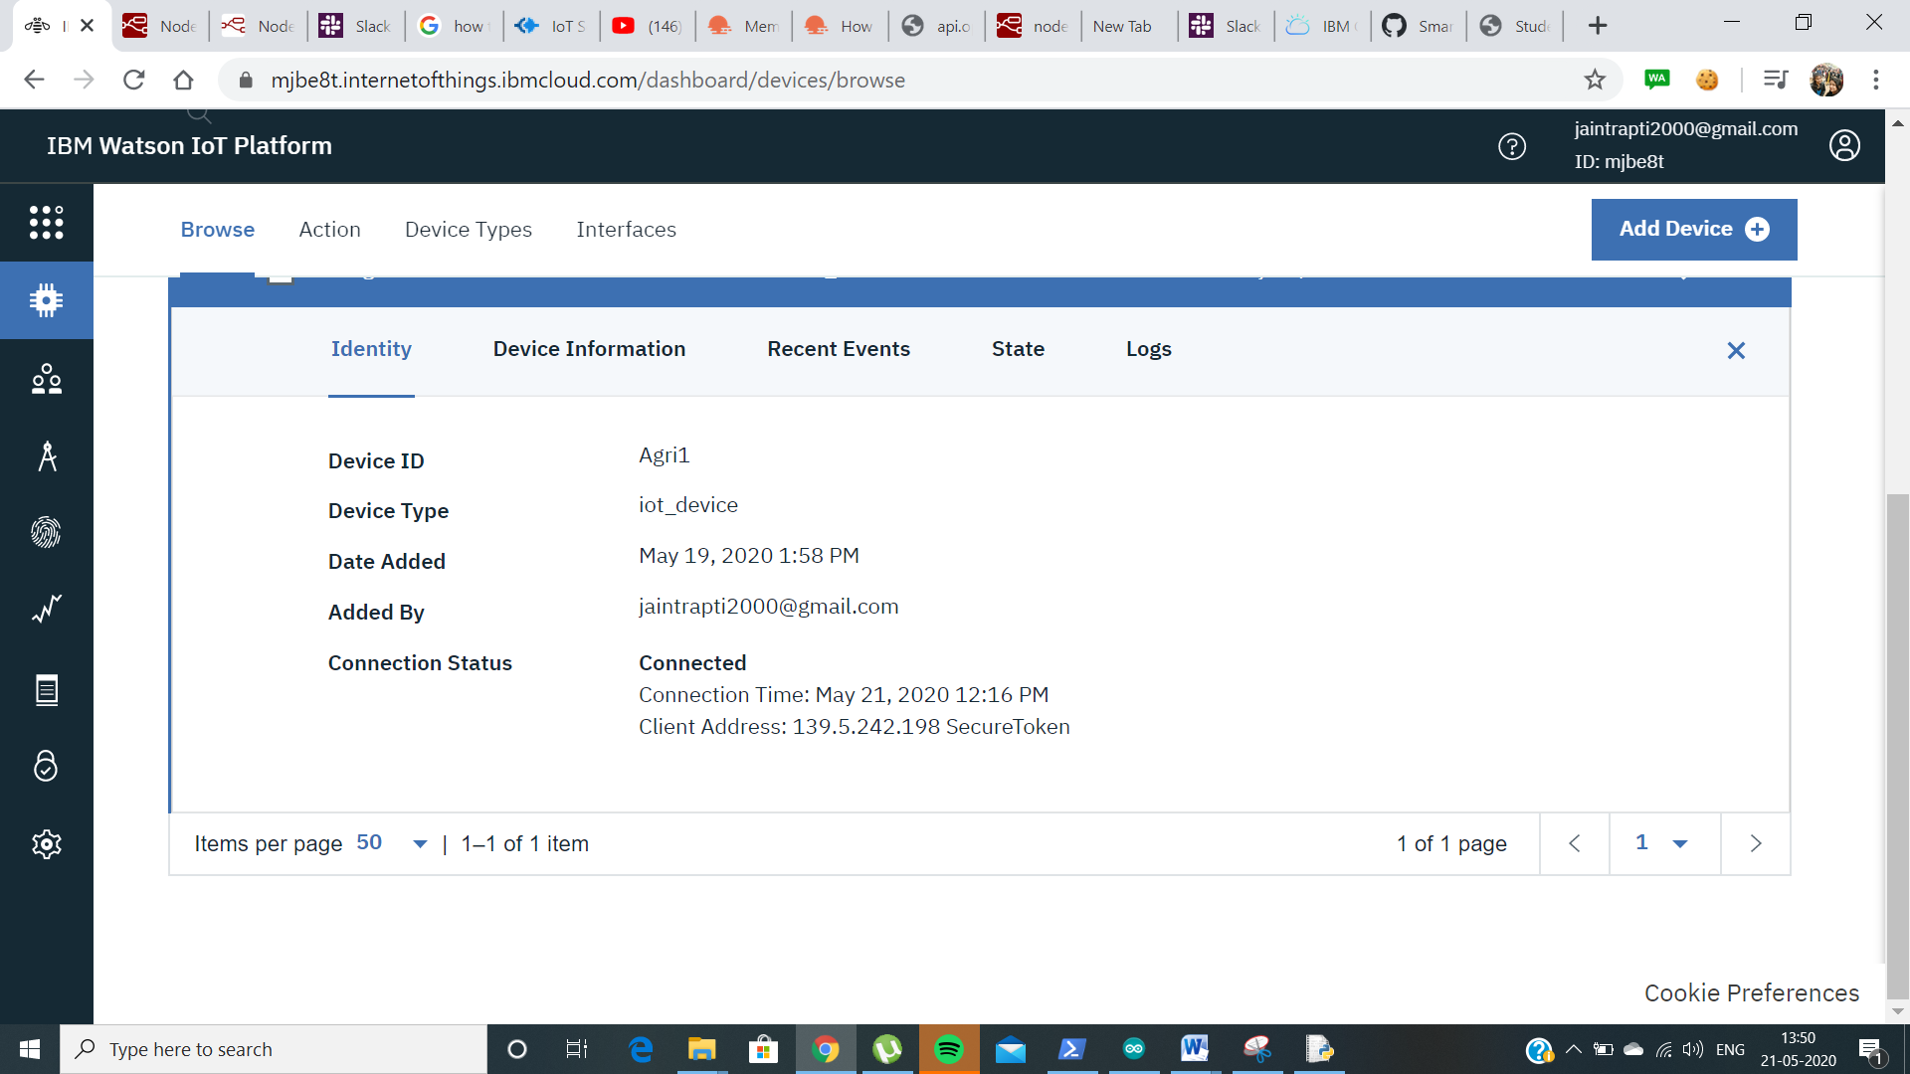
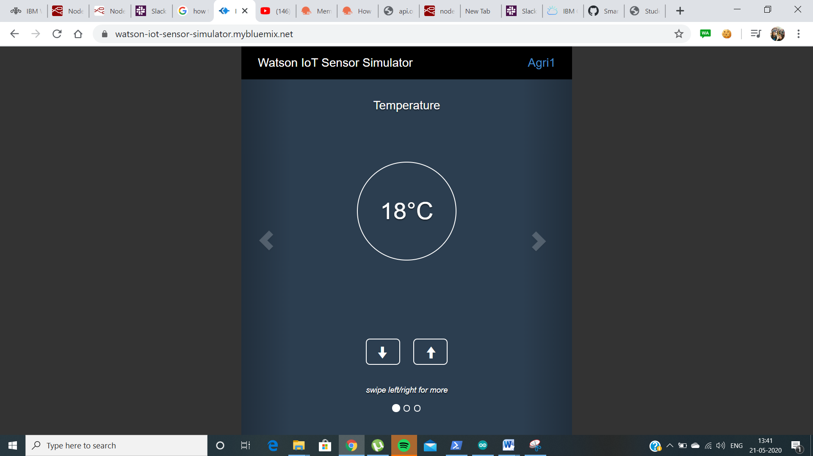
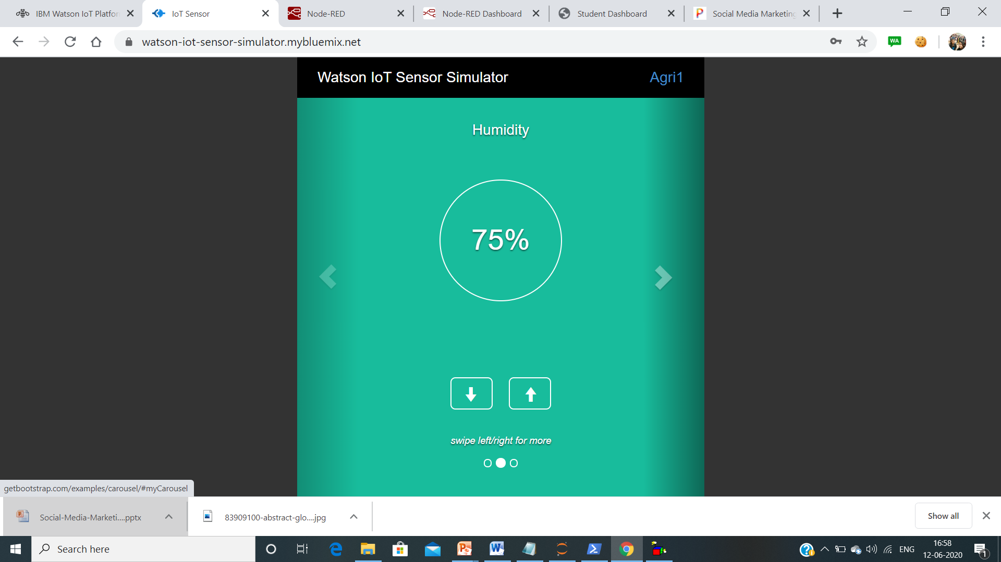
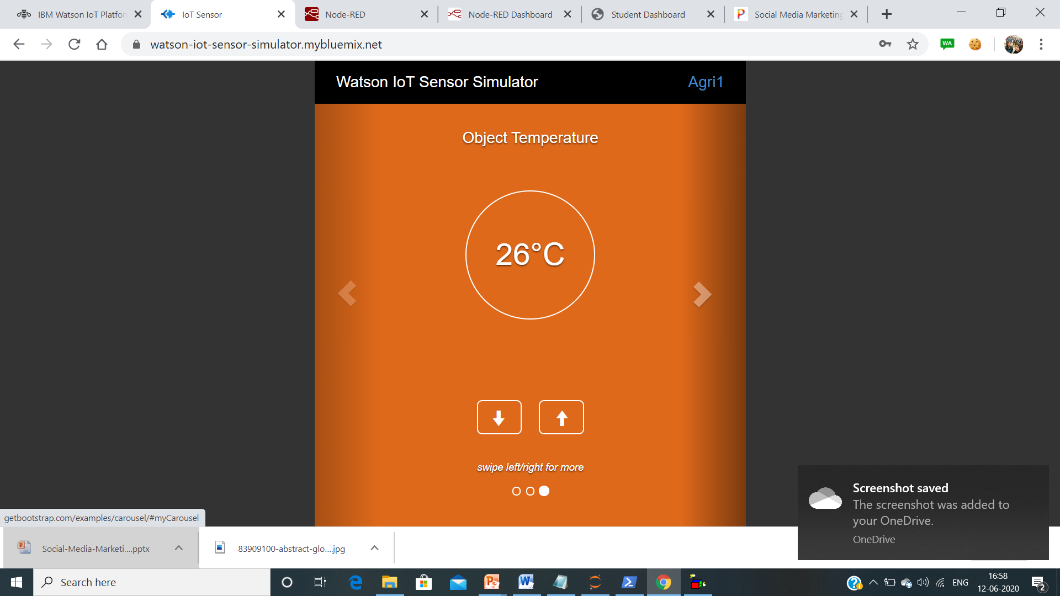
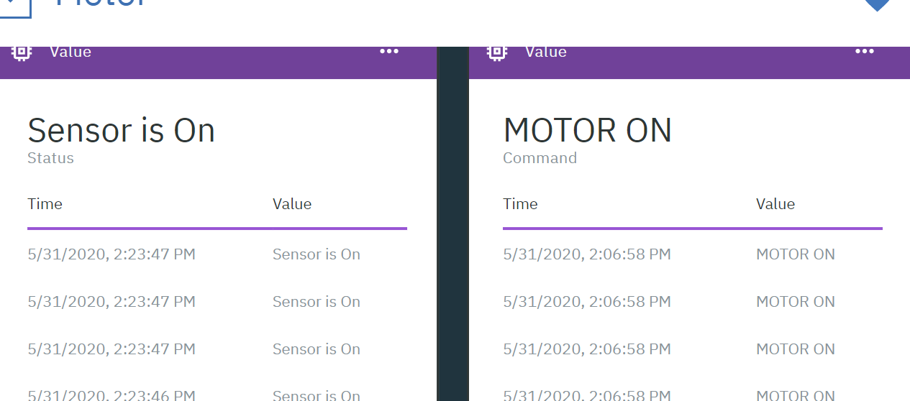
Use Of IBM Watson
IBM Watson IoT Platform is a managed, cloud-hosted service designed to make it simple to derive value from your IoT devices. Watson IoT Platform and its additional add on services - Blockchain service and analytic service - enable organizations to capture and explore data for devices, equipment, and machines, and discover insights that can drive better decision-making.
to understand.

Slide 4
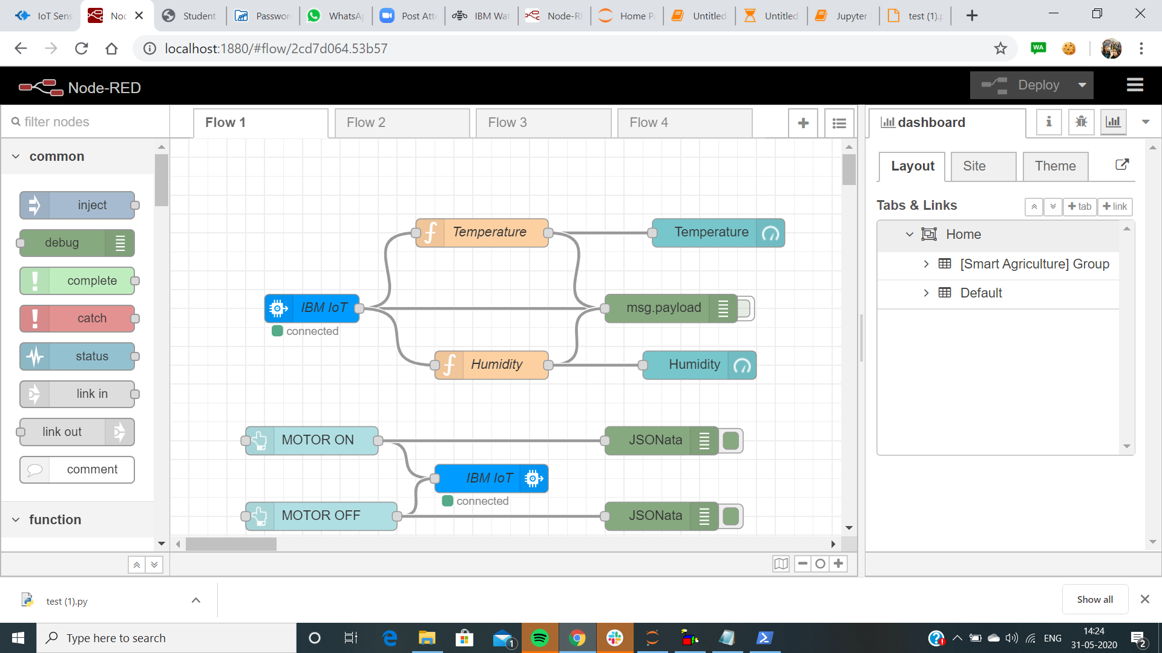
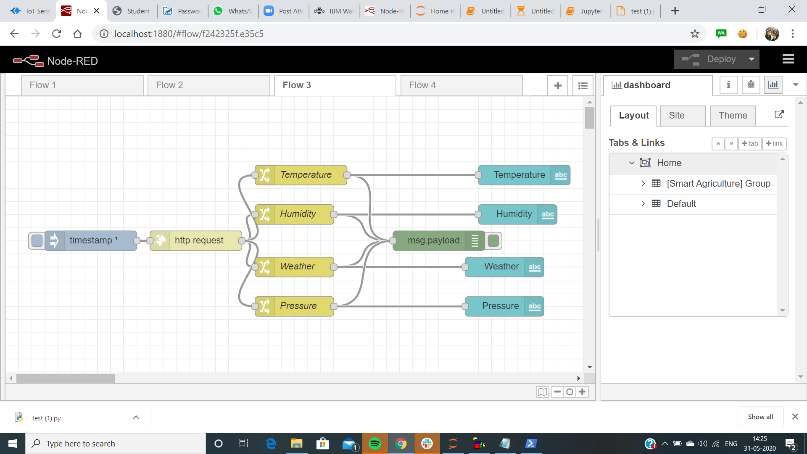
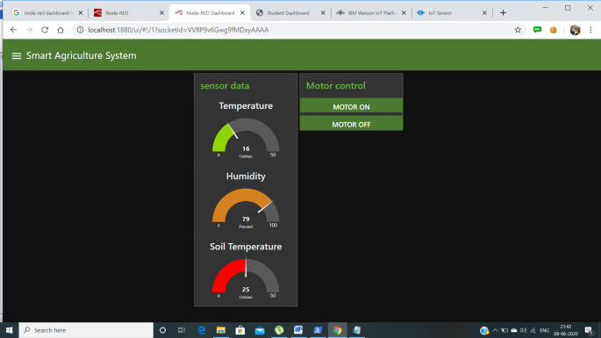
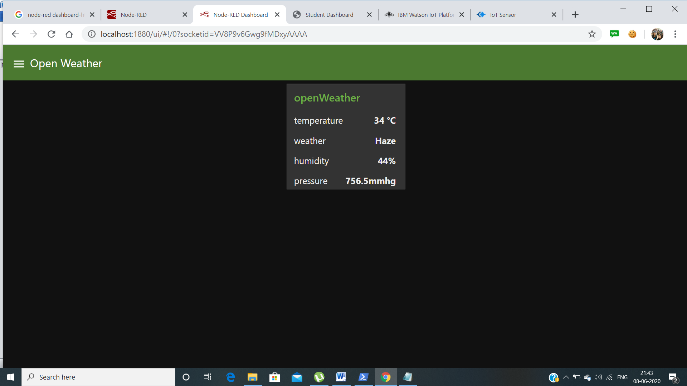
Functioning of the App
In the First flow, we have IBM nodes to get the IoT sensor data from IBM cloud and push the Motor On/Off commands from the web dashboard back to the IBM Cloud.
For the second Flow, we have 2 methods to get data from the Open Weather Map. One is Http request which I’m using to get the current weather data and display to the dashboard. The other method is to use the OWM nodes provided to get the data which I’m using for forecasting data here.

Slide 5
THANK-YOU

